Slide 1
Advanced Artificial Intelligence
Week #6
Dr. Qurat Ul Ain
Assistant Professor Dept. of AI & DS
FAST NUCES, Islamabad
Email: quratul.ain@isb.nu.edu.pk

Slide 2
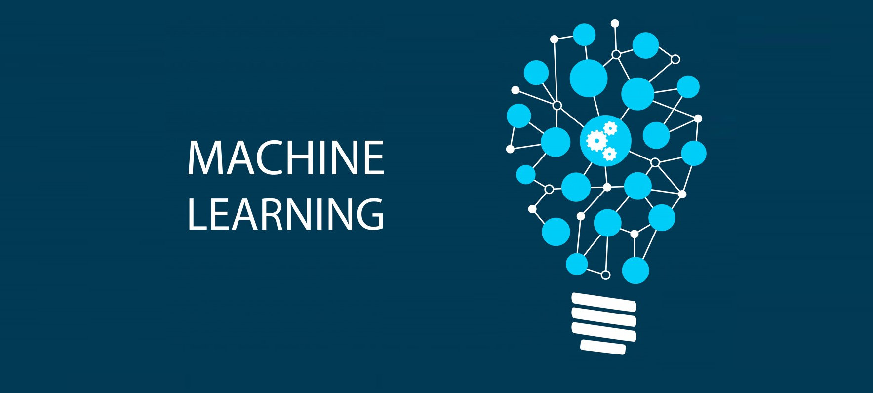
Notes:
© Copyright Showeet.com – Free PowerPoint Templates

Slide 3
Learning Objective of this Topic
AI, ML, DL (Difference)
What is Machine Learning?
Types of Machine Learning
Supervised Learning
K-Nearest Neighbour Classification Algorithm
Examples
Real World Applications
Advantages & Disadvantages
Class Activity

Slide 4
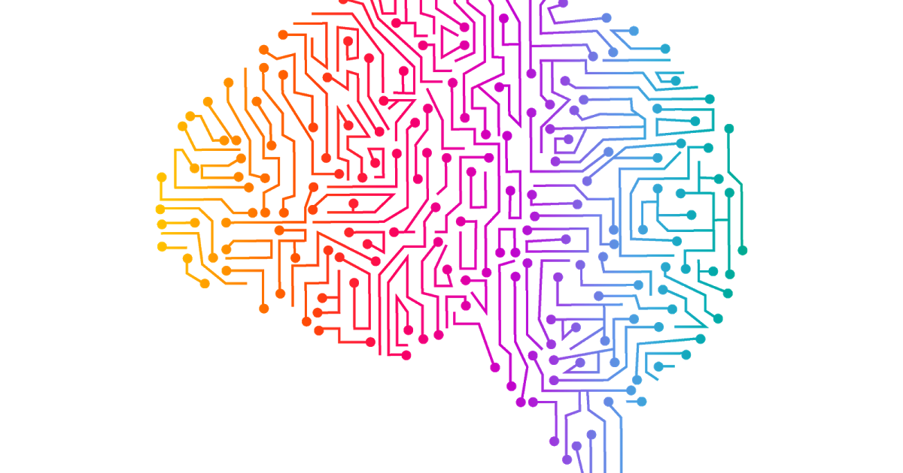
AI, ML, DL
(Difference)

Slide 5
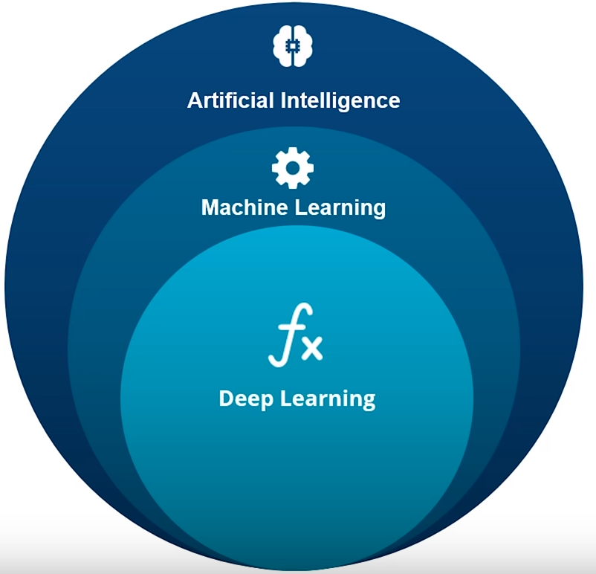
AI vs Machine Learning vs Deep Learning

Slide 6
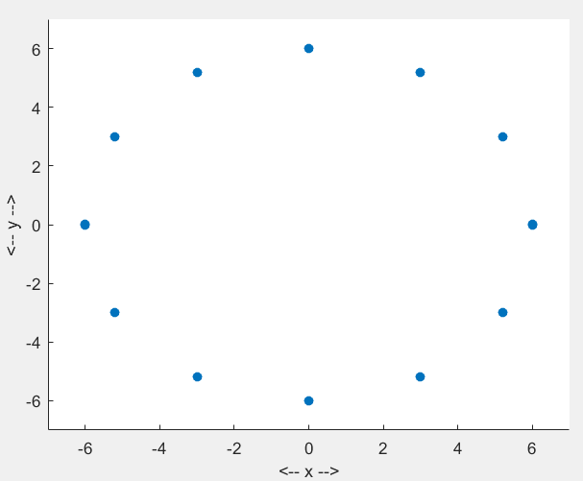
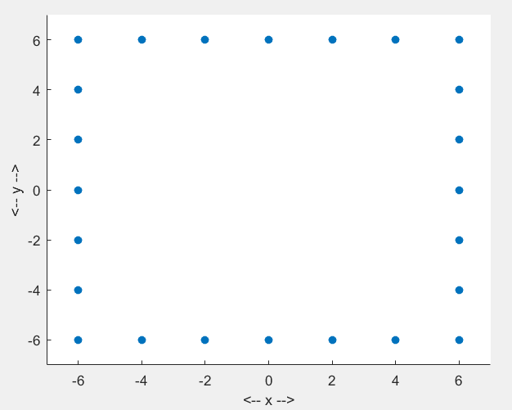
Using AI
Problem:
Given a set of connected points, find if the points form a circle or a square?
Notes:
Point representation: 2D array (C++/Java), 2D list (python) or M*2 matrix (matlab) etc….

Slide 7
Using AI
Features
1) Number of corners
2) Number of equal Sides
Rule base:
If (number of corners == 4) and (equal sides == 4)
points form square
Else
points form circle

Slide 8
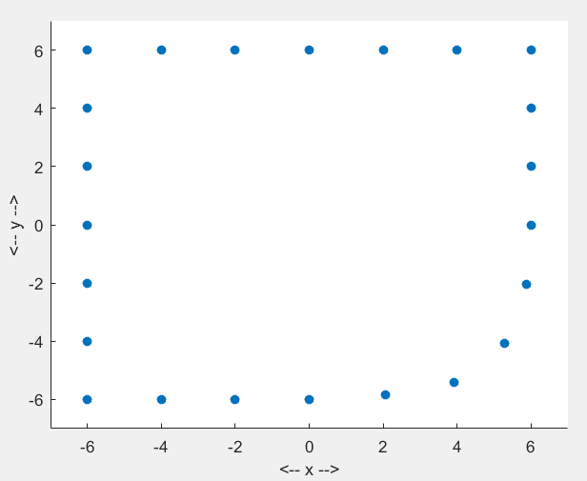
Problem with classical AI
Square or a circle?

Slide 9
Using ML
Features
1) Number of corners
2) Equal Sides
Training Phase:
Take 3 examples of circles and 3 examples of squares
For each example, compute features (number of corners, number of sides that are equal)
Also tell the computer that whether extracted features are taken from a circle or a square

Slide 10
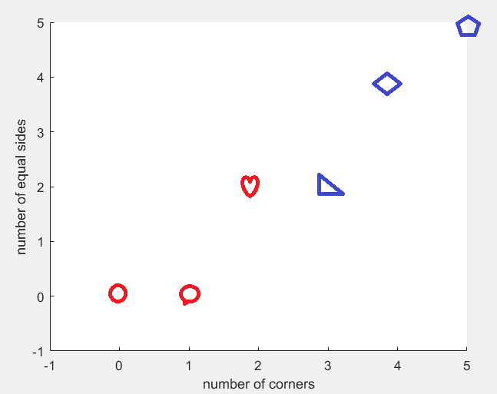
Using ML: Feature space
During training, we give machine all examples of different shapes that look similar to a circle or square
Red ones similar to a circle, blue ones similar to a square.

Slide 11
Using ML: Feature space
Class | Number of corners | Number of equal sides
Square | 5 | 5
Square | 4 | 4
Circle | 2 | 2
Square | 3 | 2
Circle | 0 | 0
Circle | 1 | 0

Slide 12
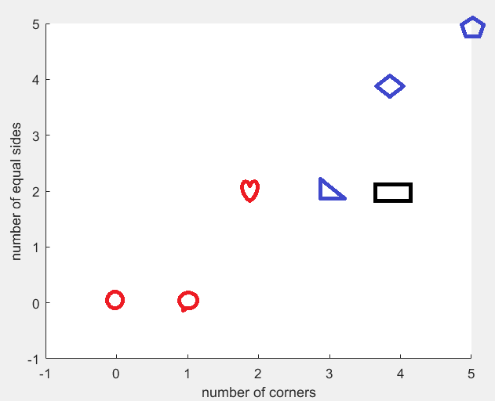
Using ML: Feature space
Testing Phase:
Let’s determine whether a set of points belonging to a rectangle is classified as a square or a circle?
Nearest Neighbor Approach:
Compute features of the test object and find that example in training the features of which is most similar to this test case.
Closest point in training belongs to a square
Test point

Slide 13
Using ML: Feature space
Class | Number of corners | Number of equal sides
Square | 5 | 5
Square | 4 | 4
Circle | 2 | 2
Square | 3 | 2
Circle | 0 | 0
Circle | 1 | 0
Class | Number of corners | Number of equal sides
? | 4 | 2

Slide 14
Using DL
No need of determining features
Just let an artificial neural network learn what type of features are useful for a given task.
In classical AI and ML, we don’t feed all points to an algorithm directly. We first compute features and then feed those computed features only.
In DL, we don’t compute features, we feed input directly to a network.

Slide 15
Using DL
(x1, y1)
(x2, y2)
a1
a11
a2
circle
Assume that every example contain 10 points arranged in circle or a square.
Training Phase:
Take 3 examples of circles and 3 examples of squares
Also tell the computer that whether extracted features are taken from a circle or a square
For each example, adjust 11 parameters such that the output for each example is +ve for circle and –ve for square.
a3
a4
no
If > 0
yes
square
a10
(x10, y10)
a1*(x1+y1)+a2*(x2+y2)+….+a10*(x10+y10)+a11 > 0 (for all square examples in training)
a1*(x1+y1)+a2*(x2+y2)+….+a10*(x10+y10)+a11 <= 0 (for all circle examples in training)

Slide 16
Using DL
(x1, y1)
(x2, y2)
a1
a11
a2
circle
The whole purpose of training is to calculate set of 11 parameters (a1,a2,…,a11)
Test Phase:
Multiply and add those 11 parameters with input test points to see if the output is +ve or –ve. If +ve then given test case/example is a square, otherwise a circle.
a3
a4
no
If > 0
yes
square
a10
(x10, y10)
a1*(x1+y1)+a2*(x2+y2)+….+a10*(x10+y10)+a11 = ?

Slide 17
Summary
Scheme | Training Set required | Pre-Determined Features required
AI | No | Yes
ML | Yes | Yes
DL | Yes | No

Slide 18
What is Machine Learning?

Slide 19
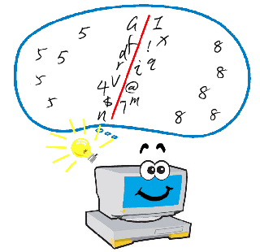

What is Machine Learning?
Make the machine ‘learn’ some thing
Evaluate how good the machine has ‘learned’

Slide 20
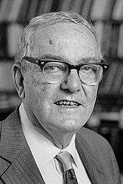
Machine Learning
“Machine learning is concerned with computer programs that automatically improve their performance through experience.”
- Herbert Simon
“A computer program is said to learn from experience E with respect to some classes of tasks T and performance measure P, if its performance at task in T, as measured by P, improves with the experience E.” (Tom Mitchell 1998)
Learning = Improving with experience at some task
Improve over task T,
With respect to performance measure, P
Based on experience, E.

Slide 21
Machine Learning
Field of study that gives computers the ability to learn without being explicitly programmed.
Arthur Sameul (1959)

Slide 22
Machine Learning
Machine learning is programming computers to optimize a performance criterion using example data or past experience.
Tom Mitchell (1998)

Slide 23
Machine Learning
Learning = Improving with experience over some task
A computer program is said to learn from experience E with respect to some task T and performance measure P, if its performance at task T, as measured by P, improves with experience E

Slide 24
Traditional Programming
Data Program
Computer
Output
Machine Learning
Data Output
Computer
Program
4

Slide 25
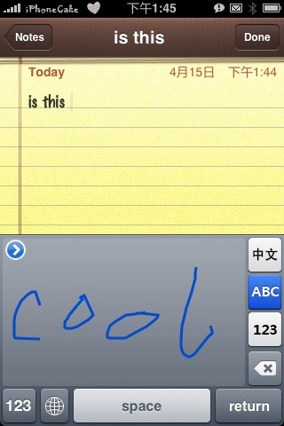
Learning Problems – Examples
Handwriting recognition learning problem
Task T: recognizing handwritten words within images
Performance measure P: percent of words correctly recognized
Training experience E: a database of handwritten words with given classifications

Slide 26
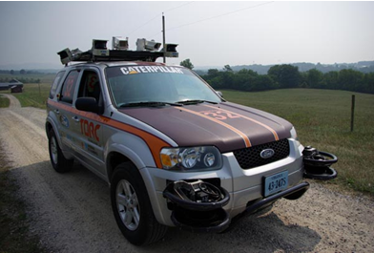
Learning Problems – Examples
A robot driving learning problem
Task T: driving on public four-lane highways using vision sensors
Performance measure P: average distance traveled before an error (as judged by human overseer)
Training experience E: a sequence of images and steering commands recorded while observing a human driver

Slide 27
Machine Learning
There is no need to “learn” to calculate payroll
Learning is used in:
Data mining programs that learn to detect fraudulent credit card transactions
Programs that learn to filter spam email
Programs that learn to play checkers/chess
Autonomous vehicles that learn to drive on public highways
Self customizing programs
And many more…

Slide 28
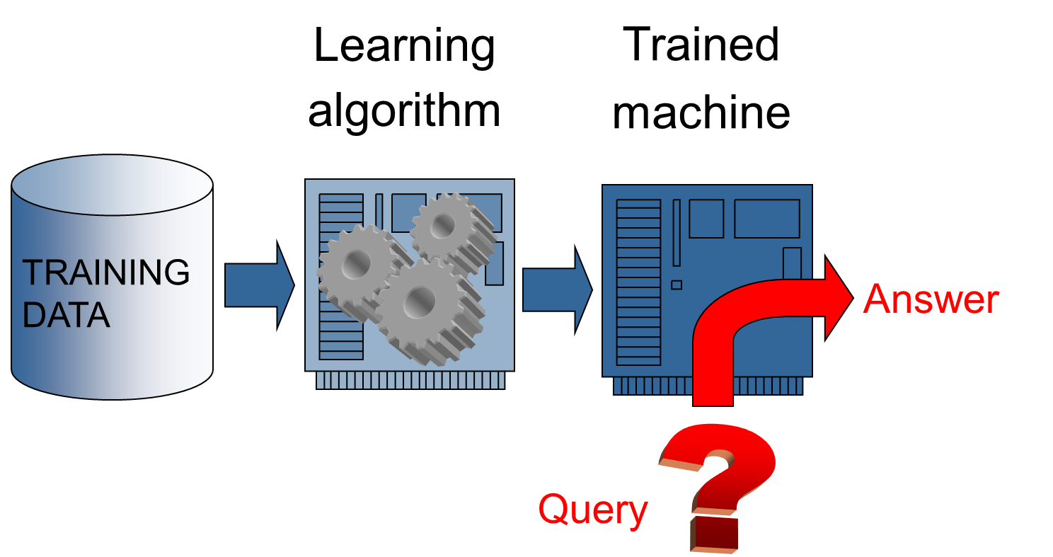
Machine learning

Slide 29
Types of Machine Learning

Slide 30
Types of Machine Learning
– Supervised learning: learn mapping from attributes to “target” Classification: target variable is discrete (e.g., spam email) Regression: target variable is real-valued (e.g., stock market)
– Unsupervised learning: no target variable; “understand” data structure Clustering: grouping data into K groups
– Other types of learning • Reinforcement learning: e.g., game-playing agent • Learning to rank, e.g., document ranking in Web search • And many others….

Slide 31
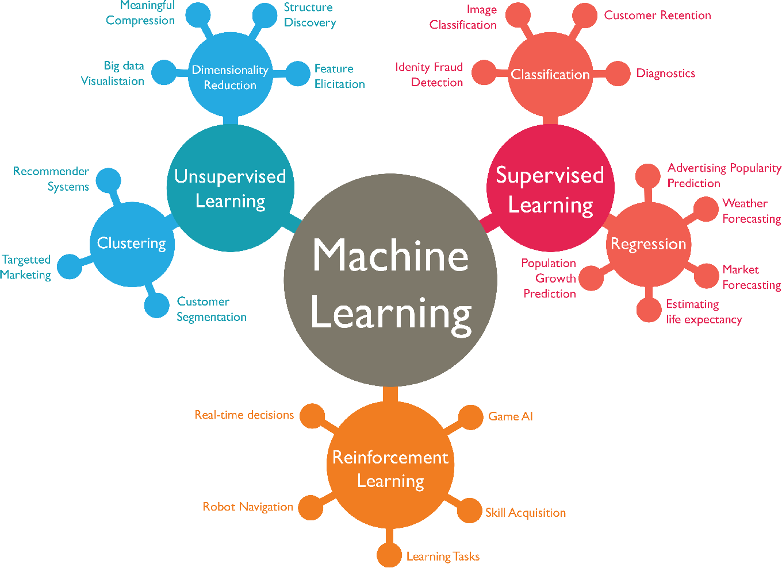
Machine Learning Types

Slide 32
Supervised Learning
Requires a labelled training set. A training set comprises of object belonging to different labels/classes.
Example (face recognition):
Training Set: 10 persons or labels with 3 face images per person, each from different pose. We have 30 images in total. Labels in this case are names of each person (string).
Testing Phase: Take a random person from those 10, take his/her image from random pose and random facial expression (sad, smily etc) and ask which person that face belongs to.

Slide 33
Supervised Learning
Example (regression, estimating price of a plot):
Training Set: Imagine from pwd housing society, we have 10 plots and for each plot we know its covered area in square meters along with the price. Price in this case is the label (floating number)
Testing Phase: Estimate the price (label) of a random plot given its covered area.

Slide 34
Unsupervised Learning
No labelled training set required.
Example (Clustering):
Imagine you have 50 students and for each student you know his/her marks out of 100. Divide these 50 students in good, average and worst categories based upon their marks.
Label in this case is one of the three strings (“good”, “average” or “bad”). Here you have a training set (a list of marks of those 50 students) but you don’t know the label of each of that student (whether that student belongs to a “good” category or one of the other two. That is what you have to find out!

Slide 35
Reinforcement Learning
In reinforcement learning the agent learns from a series of reinforcements—rewards or punishments.
For example, the lack of a tip at the end of the journey gives the taxi agent an indication that it did something wrong. The two points for a win at the end of a chess game tells the agent it did something right.

Slide 36
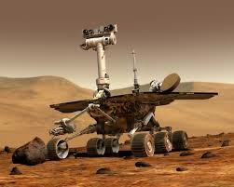
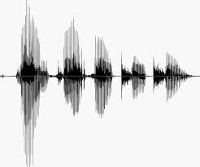
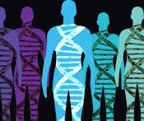
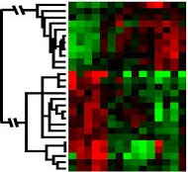
When Do We Use ML?
ML is used when:
Human expertise does not exist (navigating on Mars)
Humans can’t explain their expertise (speech recognition)
Models must be customized (personalized medicine)
Models are based on huge amounts of data (genomics)
Learning isn’t always useful:
There is no need to “learn” to calculate payroll
Based on slide by E. Alpaydin

Slide 37






Designing a Learning System
Choose the training experience
Choose exactly what is to be learned
– i.e. the target function
Choose how to represent the target function
Choose a learning algorithm to infer the target function from the experience
Training data
Learner
Environment/ Experience
Knowledge
Testing data
Performance Element

Slide 38
Training vs. Test Distribution
We generally assume that the training and test examples are independently drawn from the same overall distribution of data
– We call this “i.i.d” which stands for “independent and identically distributed”
If examples are not independent, requires collective classification
If test distribution is different, requires transfer learning

Slide 39
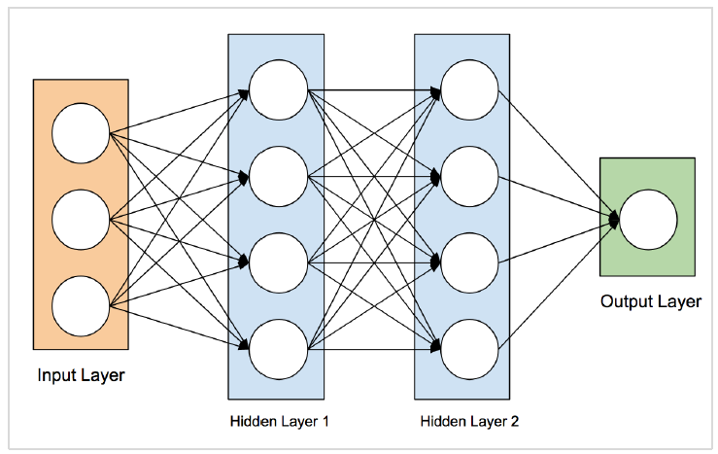
Artificial Neural Network
The idea of artificial neural networks was derived from the neural networks in the human brain. The human brain is really complex. Carefully studying the brain, the scientists and engineers came up with an architecture that could fit in our digital world of binary computers. One such typical architecture is shown in the diagram below:

Slide 40
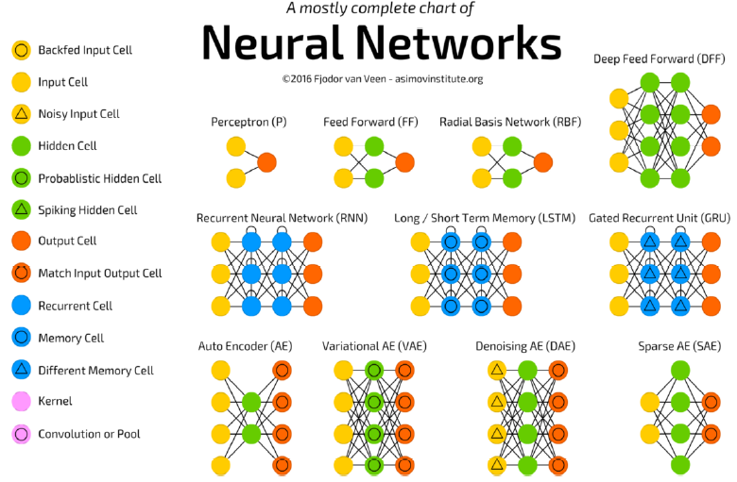
ANN Architectures

Slide 41
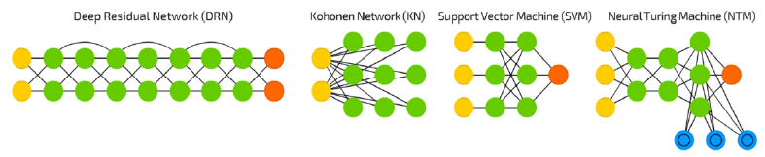
ANN Architectures
Each architecture is developed for a specific type of application. Thus, when you use a neural network for your machine learning application, you will have to use either one of the existing architecture or design your own. The type of application that you finally decide upon depends on your application needs. There is no single guideline that tells you to use a specific network architecture.
Source: https://towardsdatascience.com/the-mostly-complete-chart-of-neural-networks-explained-3fb6f2367464

Slide 42
Deep Learning
The deep learning is a model based on Artificial Neural Networks (ANN), more specifically Convolutional Neural Networks (CNN)s.
There are several architectures used in deep learning such as deep neural networks, deep belief networks, recurrent neural networks, and convolutional neural networks.
These networks have been successfully applied in solving the problems of computer vision, speech recognition, natural language processing, bioinformatics, drug design, medical image analysis, and games.
The deep learning requires huge processing power and humongous data, which is generally easily available these days.

Slide 43
Deep Learning
Deep Learning uses ANN. First we will look at a few deep learning applications that will give you an idea of its power.
Applications
Deep Learning has shown a lot of success in several areas of machine learning applications.
Self-driving Cars: The autonomous self-driving cars use deep learning techniques. They generally adapt to the ever changing traffic situations and get better and better at driving over a period of time.
Speech Recognition: Another interesting application of Deep Learning is speech recognition. All of us use several mobile apps today that are capable of recognizing our speech. Apple’s Siri, Amazon’s Alexa, Microsoft’s Cortena and Google’s Assistant – all these use deep learning techniques.
Mobile Apps: We use several web-based and mobile apps for organizing our photos. Face detection, face ID, face tagging, identifying objects in an image – all these use deep learning.

Slide 44
Deep Learning
Untapped Opportunities of Deep Learning
Agriculture is one such industry where people can apply deep learning techniques to improve the crop yield.
Consumer finance is another area where machine learning can greatly help in providing early detection on frauds and analyzing customer’s ability to pay.
Deep learning techniques are also applied to the field of medicine to create new drugs and provide a personalized prescription to a patient.
The possibilities are endless and one has to keep watching as the new ideas and developments pop up frequently.

Slide 45
Deep Learning
What is Required for Achieving More Using Deep Learning?
To use deep learning, supercomputing power is a mandatory requirement. You need both memory as well as the CPU to develop deep learning models.
Fortunately, today we have an easy availability of HPC – High Performance Computing.
Due to this, the development of the deep learning applications that we mentioned above became a reality today and in the future too we can see the applications in those untapped areas that we discussed earlier.

Slide 46
Deep Learning
Deep Learning - Disadvantages
Some of the important points that you need to consider before using deep learning are listed below:
Black Box approach
Duration of Development
Amount of Data
Computationally Expensive

Slide 47
ML in a Nutshell
Tens of thousands of machine learning algorithms
Hundreds new every year
Every ML algorithm has three components:
Representation
Optimization
Evaluation
Slide credit: Pedro Domingos

Slide 48
Various Function Representations
Numerical functions
Linear regression
Neural networks
Support vector machines
Symbolic functions
Decision trees
Rules in propositional logic
Rules in first-order predicate logic
Instance-based functions
Nearest-neighbor
Case-based
Probabilistic Graphical Models
Naïve Bayes
Bayesian networks
Hidden-Markov Models (HMMs)
Probabilistic Context Free Grammars (PCFGs)
Markov networks

Slide 49
Various Search/Optimization Algorithms
Gradient descent
Perceptron
Backpropagation
Dynamic Programming
HMM Learning
PCFG Learning
Divide and Conquer
Decision tree induction
Rule learning
Evolutionary Computation
Genetic Algorithms (GAs)
Genetic Programming (GP)
Neuro-evolution

Slide 50
Evaluation
Accuracy
Precision and recall
Squared error
Likelihood
Posterior probability
Cost / Utility
Margin
Entropy
K-L divergence
etc.
Slide credit: Pedro Domingos

Slide 51


ML in Practice
Understand domain, prior knowledge, and goals
Data integration, selection, cleaning, pre-processing, etc.
Learn models
Interpret results
Consolidate and deploy discovered knowledge
Loop
Based on a slide by Pedro Domingos

Slide 52
Conclusion
ML is a technique of training machines to perform the activities a human brain can do, albeit bit faster and better than an average human-being.
Today we have seen that the machines can beat human champions in games such as Chess, AlphaGO, which are considered very complex. You have seen that machines can be trained to perform human activities in several areas and can aid humans in living better lives.
Machine Learning can be a Supervised or Unsupervised. If you have lesser amount of data and clearly labelled data for training, opt for Supervised Learning.
Unsupervised Learning would generally give better performance and results for large data sets. If you have a huge data set easily available, go for deep learning techniques.

Slide 53


